Slide 1

AI-Powered Telecom Edge
Sean Wong
2025/08/05

Slide 2
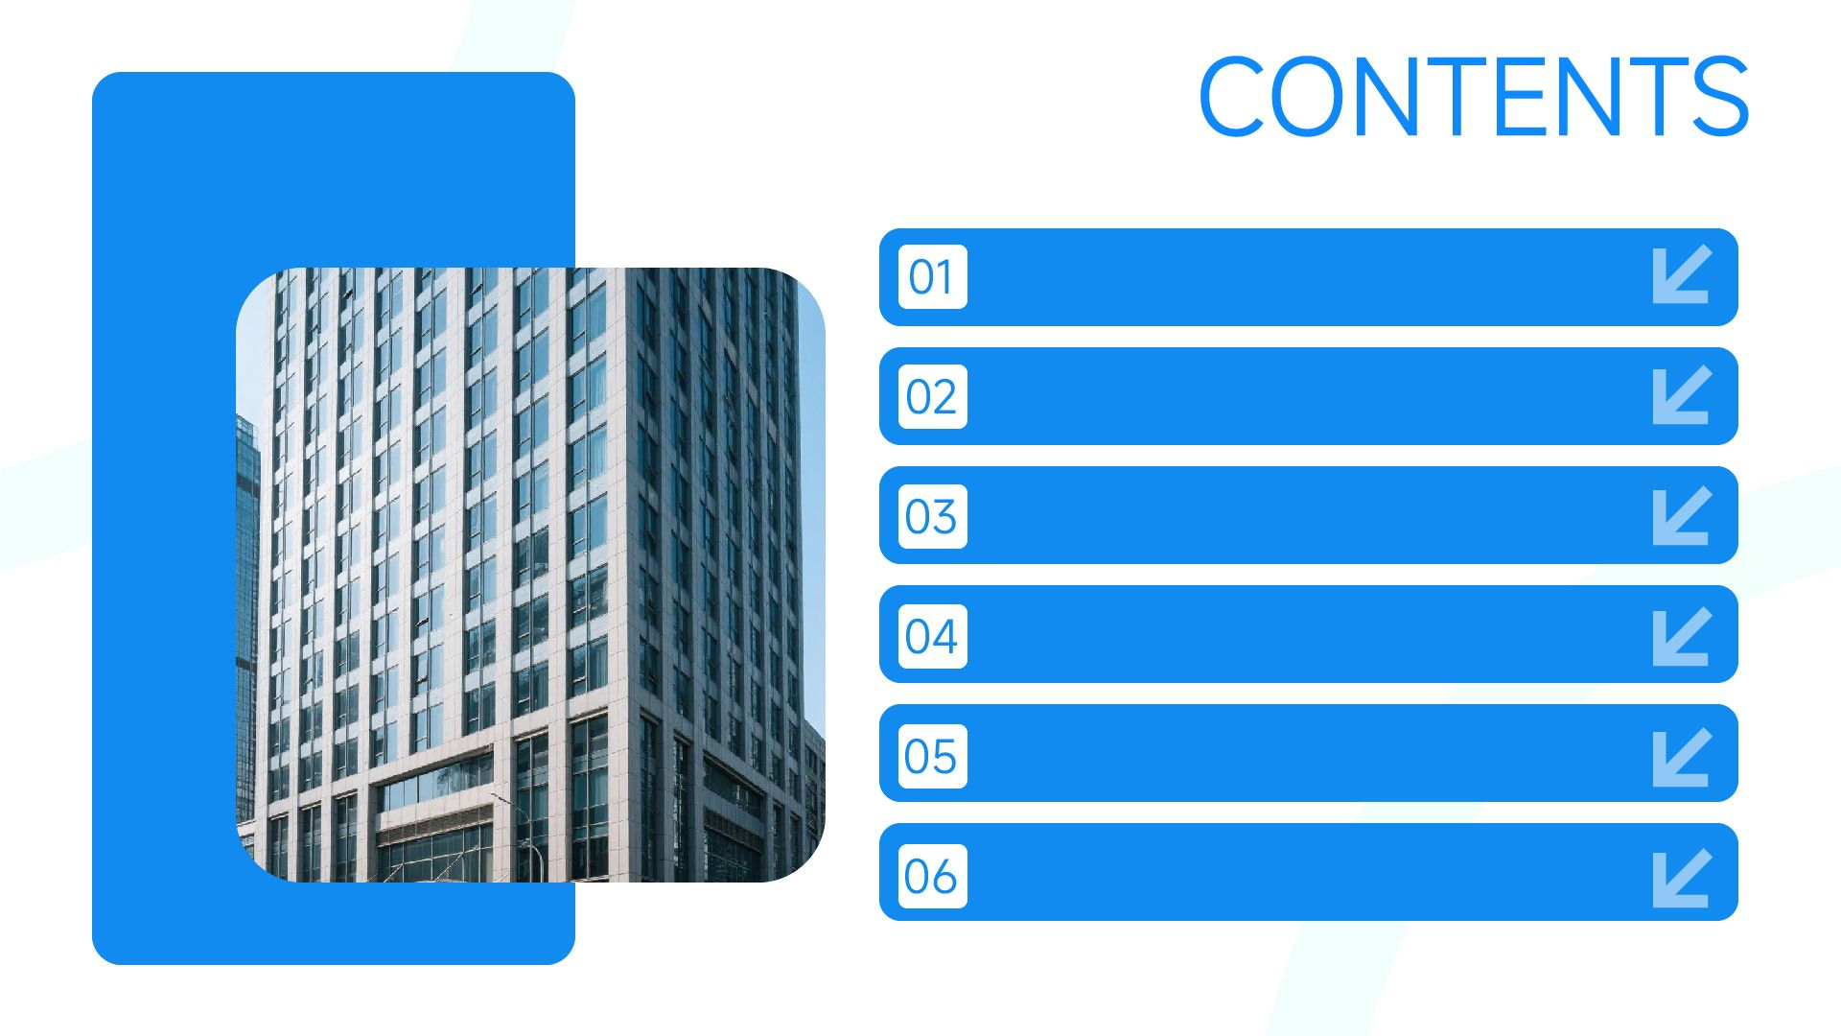
AI Telecom Landscape
Predictive Maintenance
Fraud & Security Shield
Smart Customer Care
Network Optimization
Agentic Simulation

Slide 3
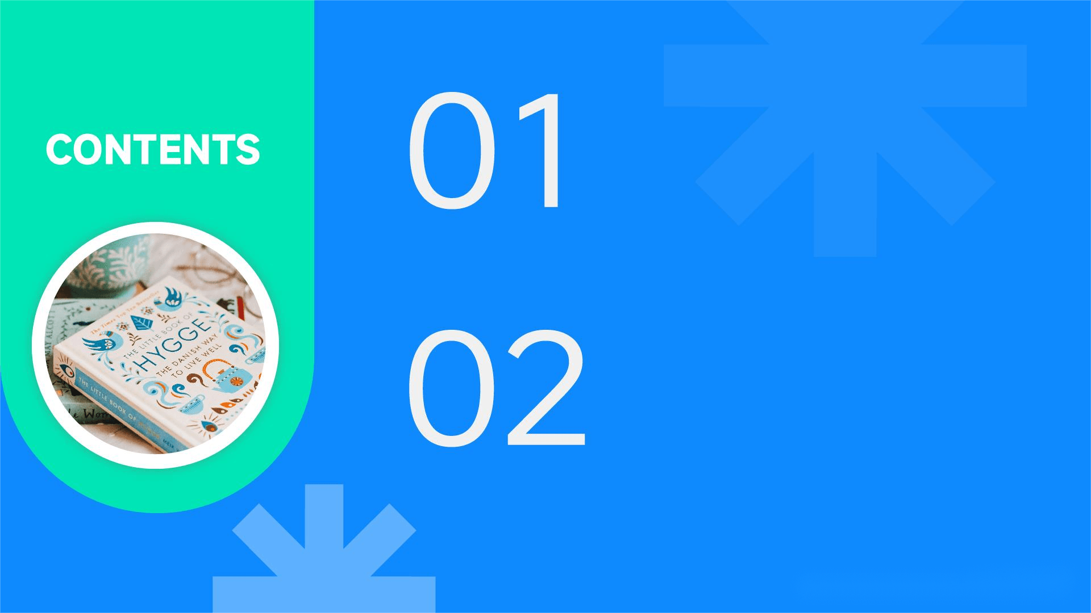
Hands-On Adoption
Next-Step Playbook

Slide 4

01
AI Telecom Landscape

Slide 5

AI Already Runs Your Network
AI now monitors network devices, base stations, and routers in real time, predicting potential equipment failures and scheduling proactive maintenance to reduce unplanned outages and ensure reliable connectivity.
AI handles routine inquiries via chatbots, IVR, or virtual assistants, providing personalized offers and troubleshooting guidance while detecting customer sentiment and escalating complex issues.
AI detects SIM card fraud, subscription fraud, and unauthorized access by monitoring network traffic for anomalies and supporting real-time incident response to protect networks and revenue streams.
AI in Network Operations
AI in Customer Service
AI in Fraud Detection

Slide 6

AI for Repetitive Tasks
Human Oversight
AI excels at repetitive tasks like network monitoring, service ticket triaging, and routine customer support, freeing telecom professionals to focus on strategic decision-making and customer experience design.
Telecom professionals retain control over network architecture planning, regulatory compliance, customer relationship strategy, and complex incident resolution, ensuring AI enhances rather than replaces human expertise.
Human-AI Network Partnership

Slide 7
02
Predictive Maintenance

Slide 8

AI Pre-Empts Base-Station Failures
Real-Time Monitoring
Automated Maintenance Scheduling
Nokia NetGuard continuously monitors base station performance metrics such as CPU usage, temperature, and network load to detect early signs of potential failures.
Juniper AI Operations automates maintenance scheduling based on predictive insights, ensuring timely repairs and minimizing service disruptions.
Reduced Unplanned Outages
Predictive Analytics
Ericsson Cognitive Network Manager uses predictive analytics to forecast equipment failures days in advance, allowing for proactive maintenance scheduling and reducing downtime.
IBM Maximo for Telecom reduces unplanned outages by identifying and addressing potential issues before they escalate, improving network reliability.

Slide 9

Early Detection
AI algorithms detect fiber optic signal degradation early, enabling timely repairs and preventing service disruptions that impact customer satisfaction.
Fiber Degradation Detected Early

Slide 10
03
Fraud & Security Shield

Slide 11

Real-Time Fraud Detection
Subex ROC uses AI to detect SIM-swap fraud in real time by analyzing activation requests against device history, location velocity, and dark-web signals, protecting subscriber accounts.
AI Blocks SIM-Swap Fraud Fast
Reduced Fraud Losses
By halting SIM-swap attempts, AI reduces account-takeover losses and preserves subscriber trust while lowering chargebacks that erode wholesale and roaming margins.

Slide 12
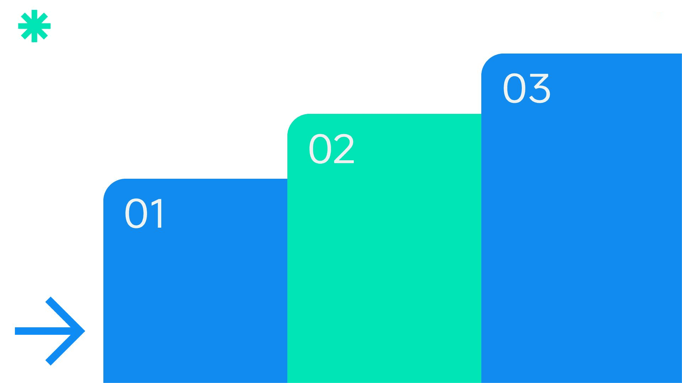
DDoS Patterns Neutralized Auto
Brand Reputation Protection
By neutralizing DDoS attacks, AI protects the brand reputation of telecom providers, ensuring consistent service quality for both consumer and enterprise customers.
Automated Mitigation
AI triggers automated mitigation measures such as scrubbing or BGP black-holing without human intervention, maintaining service availability during attacks.
Baseline Traffic Modeling
Darktrace AI models baseline network traffic to detect volumetric or application-layer DDoS attacks within seconds, ensuring rapid response.

Slide 13
04
Smart Customer Care

Slide 14

Virtual Agents Slash Wait Times
Efficient Customer Support
IBM Watson Assistant handles billing, data add-ons, and outage FAQs via voice or chat, resolving 70% of contacts without live agents and escalating complex cases with full context.

Slide 15

Churn Risk Scores Trigger Saves
Predictive Churn Analytics
Personalized Retention Campaigns
Measurable Lifetime Value Gains
Salesforce Einstein predicts churn probability from usage drops, complaint history, and competitor offers, enabling proactive retention strategies.
AI triggers personalized discounts or device upgrades for high-value subscribers, turning reactive save-desk calls into proactive loyalty campaigns.
By retaining high-value customers, AI-driven campaigns protect revenue and improve average revenue per user, enhancing customer lifetime value.

Slide 16
05
Network Optimization

Slide 17

Real-Time Load Balancing
Cisco DNA Center reallocates spectrum and adjusts antenna power in real time to balance network load during peak traffic periods, ensuring consistent user experience.
Software-Driven Optimization
Self-Healing Cells Balance Load
AI-driven optimization defers costly hardware upgrades, providing operational savings while maintaining network performance and capacity.

Slide 18

Energy Usage Forecasting
Carrier Segment Management
Ericsson Energy Optimization forecasts traffic loads and adjusts power consumption dynamically to reduce electricity bills and carbon footprint.
AI shuts down carrier segments during low-demand periods, optimizing energy usage without compromising network performance.
Energy AI Cuts Base-Station Power
AI controls cooling fans based on real-time temperature and load conditions, further reducing energy consumption and operational costs.
By optimizing energy usage, AI supports sustainability goals while delivering measurable cost savings that improve overall network efficiency.
Cooling Fan Optimization
Sustainability and Cost Savings

Slide 19
06
Agentic Simulation

Slide 20
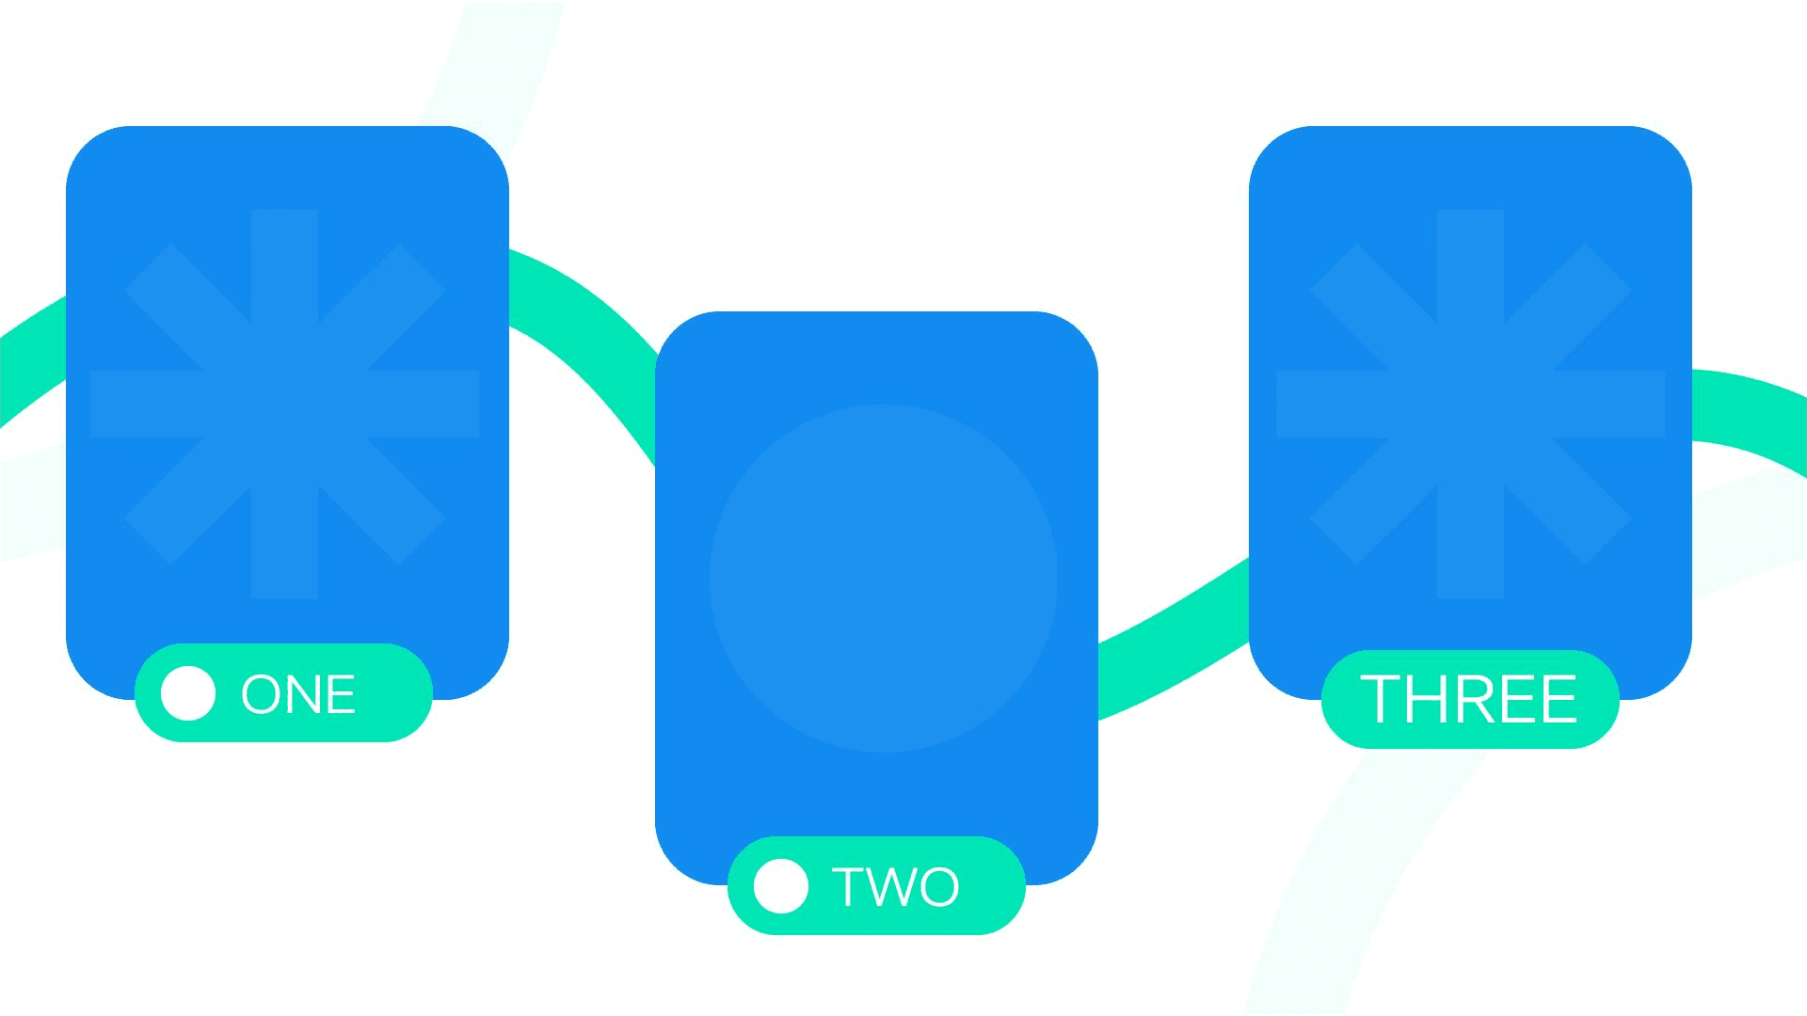
AI Simulates 5G Rollout Scenarios
Realistic Traffic Scenarios
Data-Driven Decision Making
AnyLogic Telecom sandbox generates realistic network traffic scenarios to test 5G rollouts, ensuring optimal coverage and performance.
Simulation tools provide data-driven insights, reducing risk and improving the efficiency of 5G network deployment and expansion.
Capacity Planning and Testing
AI tests infrastructure upgrades and capacity expansions, predicting service-level impact under different conditions to guide investment decisions.

Slide 21

Synthetic Traffic Trains Models
Model Training with Synthetic Data
Agentic AI generates synthetic traffic data to train fraud detection models, ensuring GDPR compliance and reducing privacy risks during vendor collaborations.

Slide 22
07
Hands-On Adoption

Slide 23

Task Triage Matrix Workshop
Teams list telecom workflows and score them on data volume, repetition, and urgency to identify tasks suitable for AI augmentation.
Evaluate tasks based on criteria such as safety, reliability, and customer interaction to determine their suitability for AI implementation.
Focus investment on tasks where AI can deliver measurable ROI and quick staff endorsement, such as reducing downtime or churn.
Develop a roadmap for continuous model retraining and human oversight to ensure AI solutions remain effective and aligned with business goals.
Identify High-Impact Tasks
Evaluate AI Suitability
Focus on High-ROI Areas
Plan for Continuous Improvement

Slide 24

Apply Predictive Models
Using sample base-station data, apply ML models to predict hardware failures and schedule proactive maintenance.
Predict Failure with Sensor Data
Improve Uptime and SLA Compliance
Experience how data-driven maintenance improves network uptime and aligns with customer SLAs and field-team availability.

Slide 25
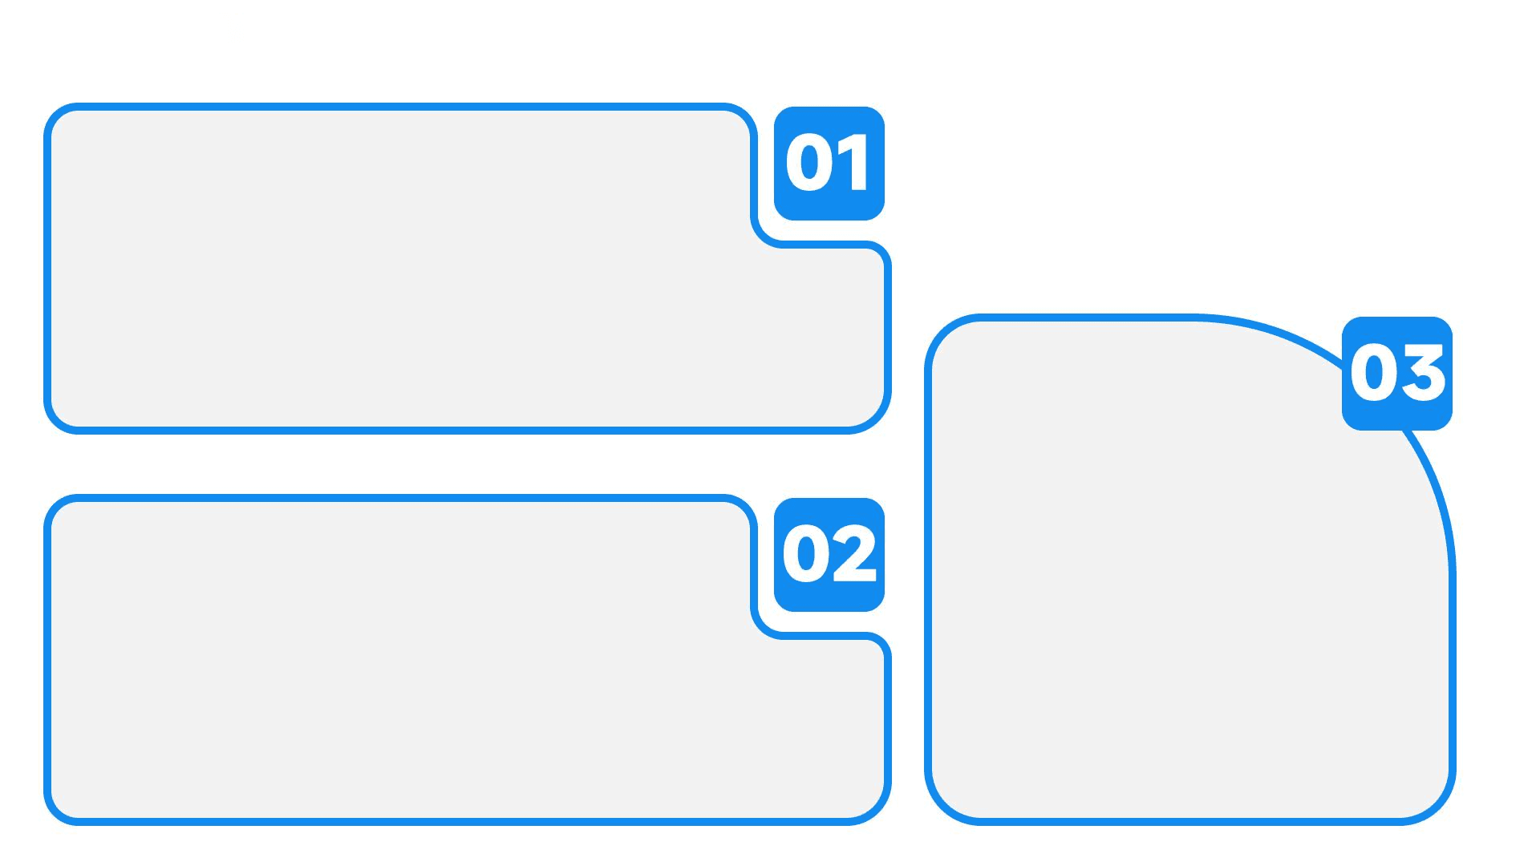
Churn Score Simulation Drill
Build Churn Prediction Models
Participants build logistic regression models to generate churn probabilities based on customer usage data.
Protect Revenue and Enhance Loyalty
Design Retention Strategies
Witness how predictive analytics transform blanket discounts into precision loyalty campaigns that protect revenue and enhance customer lifetime value.
Design personalized retention offers and estimate the lifetime value saved through targeted campaigns.

Slide 26
08
Next-Step Playbook

Slide 27

Quick Reference Guide
A portable cheat sheet maps telecom domains to AI roles and tools, ensuring teams select secure, compliant solutions for network operations, customer engagement, and service planning.
One-Page Telecom AI Cheat Sheet

Slide 28
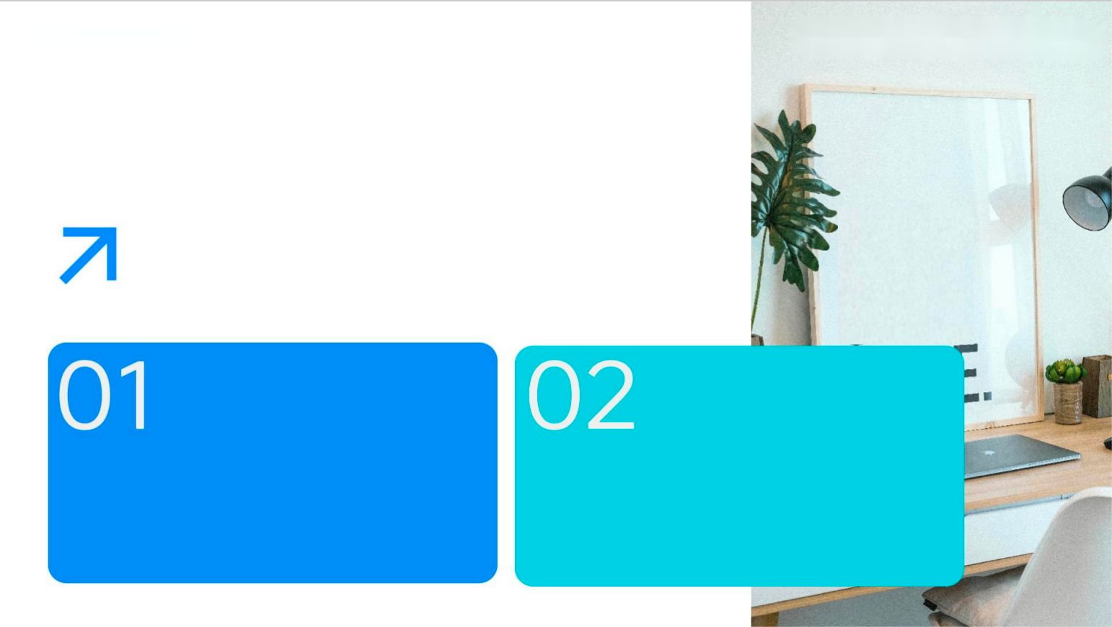
Ethical & Compliance Governance
Ensure Bias-Free Algorithms
Comply with Regulations
Confirm bias audits and transparent algorithms to ensure AI decisions are fair and unbiased, protecting subscriber rights and maintaining trust.
Align AI deployments with GDPR, FCC, and net-neutrality obligations to ensure regulatory compliance and avoid legal and reputational risks.

Slide 29

Pilot-to-Scale Roadmap
Start with High-Impact Tasks
Expand to Other Areas
Embed Continuous Improvement
Begin with tasks like failure prediction, defining baseline metrics and running pilots to capture ROI data.
Expand AI to churn and energy optimization, ensuring continuous model retraining and human oversight for safety and efficiency.
Embed continuous improvement practices to ensure AI solutions evolve with changing network conditions and business needs.

Slide 30

2025/08/05
Sean Wong

